Slide 1


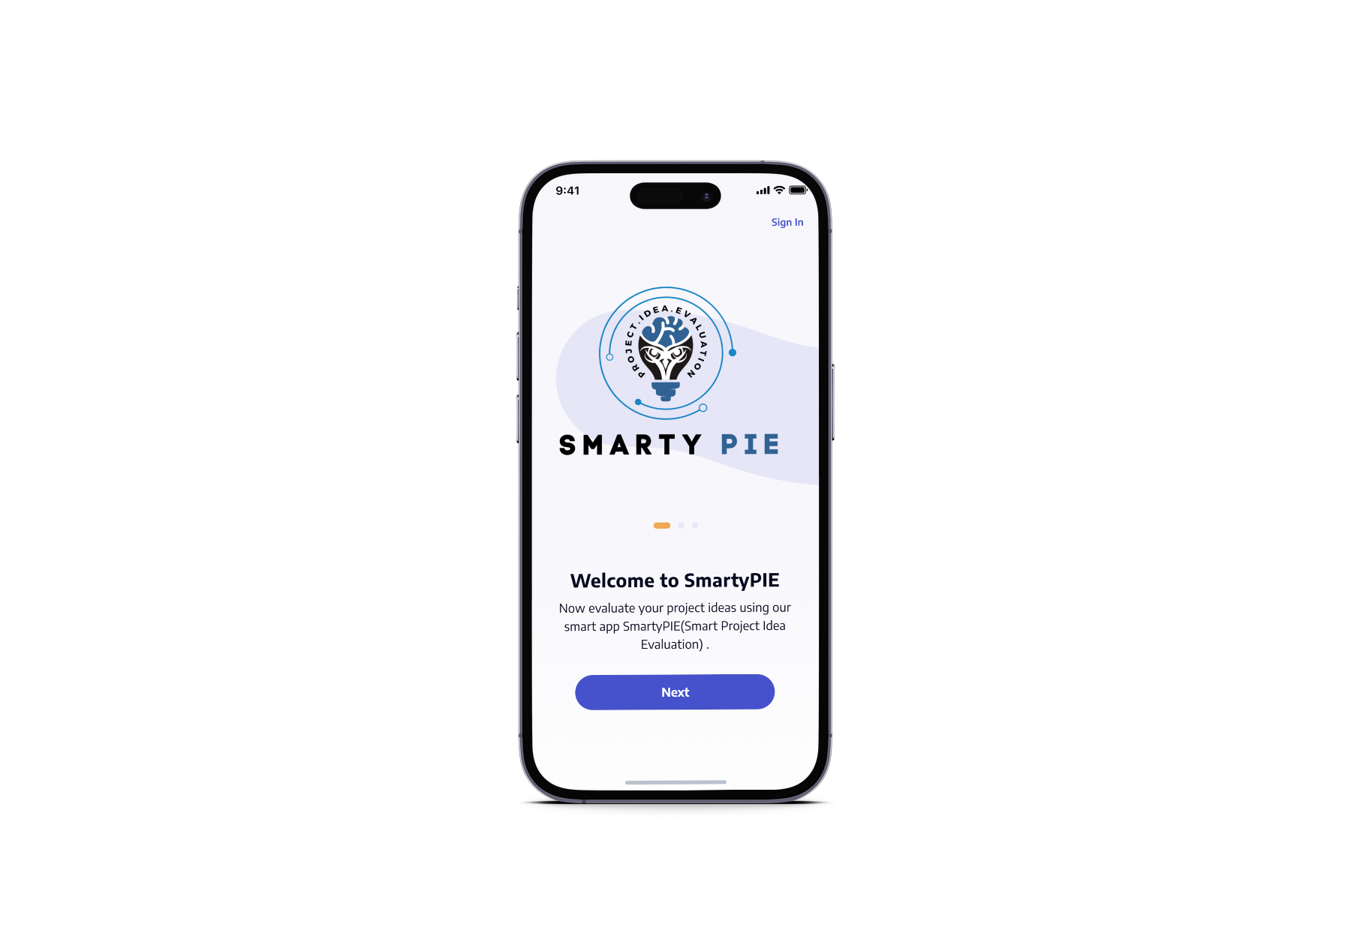





Smarty PIE
PROJECT.IDEA.EVALUATION
ACHIVEMENTS
Win Silver Medal in 39th IEEEP All Pakistan Students' Seminar 2024
Third Position at the SSUET Job Fair & Project exhibition 2024
Selected for FICS Stage 2 and awaiting the next stage

Slide 2
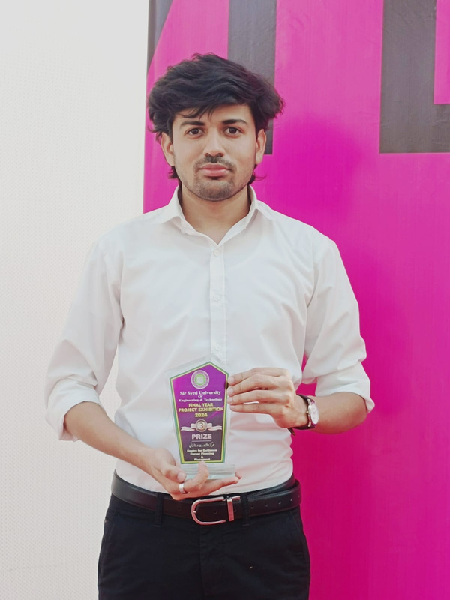

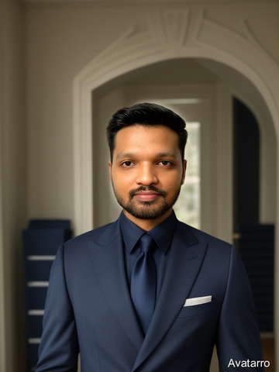
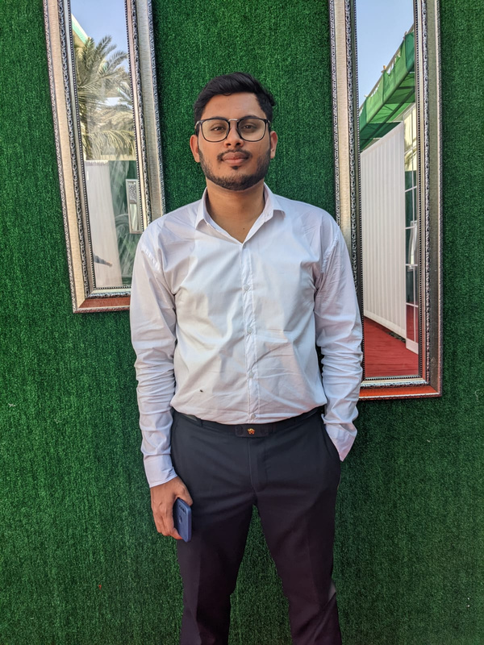
OUR TEAM
Kashan Khan Ghori
Dinesh Kumar
BSCS-070-2020S
BSCS-095-2020S
Supervised By: Dr. Anam Akbar
Co-Supervised By: Dr. Amir Mehmood
Numair Nasir
Muhammad zahid
BSCS-072-2020S
BSCS-075-2020S

Slide 3

INTRODUCTION
IDENTIFYING THE CHALLENGE
Recognizing the Limitation: Human Perspectives Restricting Idea Evaluation.
THE INNOVATIVE SOLUTION
Innovative Answer: Smarty PIE - An AI-Powered Tool for Objective Idea Assessment.
OUR VISION FOR IMPROVEMENT
Visionary Change: Revolutionizing Idea Evaluation to Ensure Objectivity and Fairness.

Slide 4
PROBLEM STATEMENT
NOVELTY ASSESSMENT
SDG ALIGNMENT
LIMITED EXPERTISE
Assessing the novelty of projects is challenging, especially when comparing with existing Ideas
Manual evaluation of a project's alignment with the SDGs is time-consuming and inconsistent
Compare projects to existing ones, suggesting enhancements for increased novelty.
INEFFICIENCY
NEED FOR A TOOL
Evaluating each project individually can be time-consuming and inefficient.
The absence of a streamlined tool highlights the demand for our comprehensive app.

Slide 5
SCAN OR ENTER SUMMARY
Takes the project’s summary as input in the form of text and analyzes them using NLP algorithms.
ACCURATE SDG ALIGNMENT
Determine project alignment with the UN's 17 SDGs using ML techniques.
SOLUTION
NOVELTY ASSESSMENT
Compare projects to existing ones, suggesting enhancements for increased novelty.
REPORT
Offer a user-friendly report for diverse users, promoting sustainable development and innovative design.

Slide 6
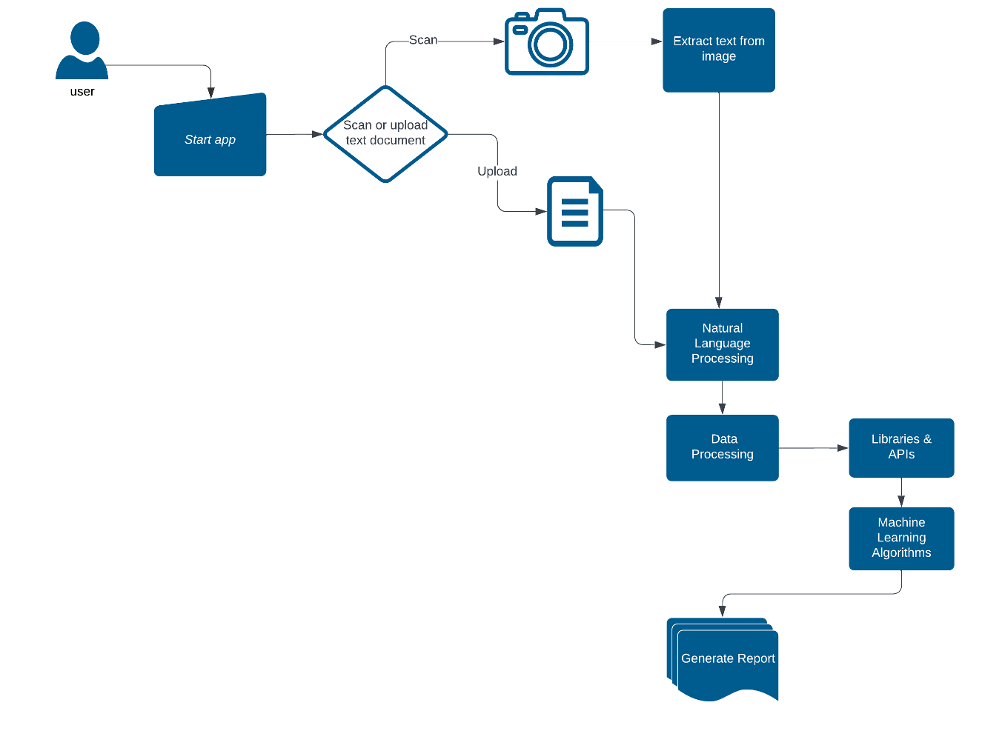
PROPOSED SYSTEM

Slide 7
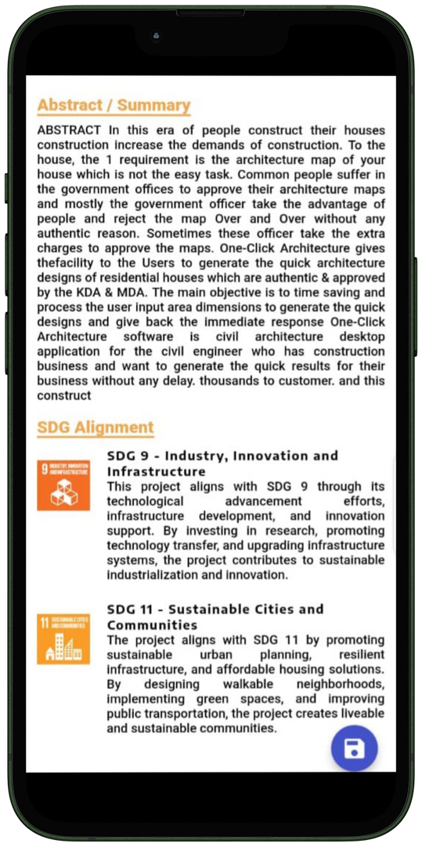
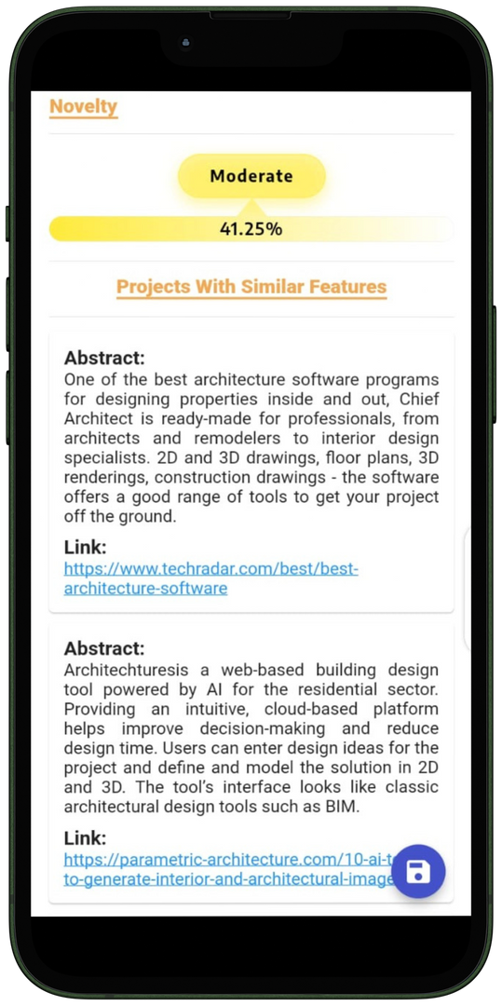
EVALUATION RESULTS

Slide 8




SDG-4 Quality Education
Smarty PIE primarily impacts SDG 4 (Quality Education) by enhancing educational quality through innovative technology, ensuring projects are objectively evaluated and aligned with sustainable development goals
SDG-9 Industry, Innovation & Infrastrucutre
SDG’S IMPACT
Smarty Pie significantly contributes to SDG 9 (Industry, Innovation, and Infrastructure) by fostering a culture of innovation in project development and assessment.
SGD-17 Partnerships For The Goals
Smarty PIE embodies SDG 17 (Partnerships for the Goals) by demonstrating collaborative efforts across different technological domains, crucial for sustainable development and educational excellence.

Slide 9

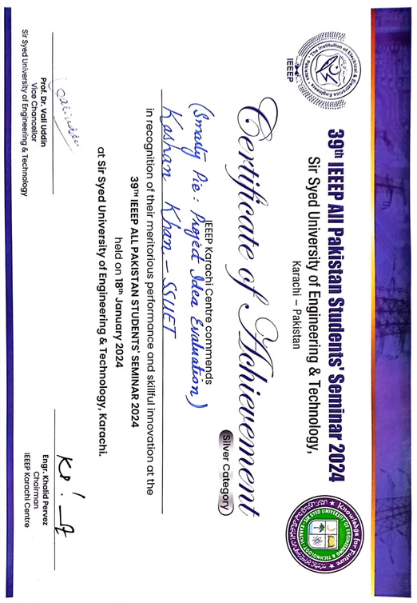
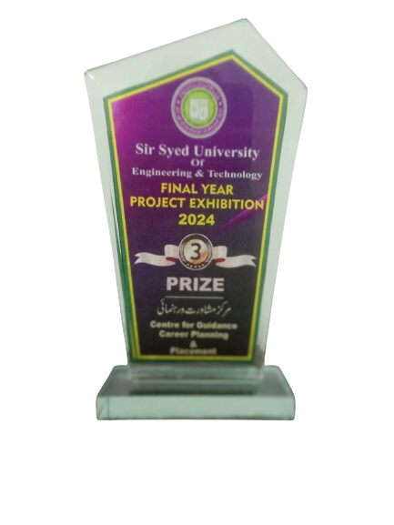

AWARDS & ACHIEVEMENTS
Selected for FICS Stage 2 and awaiting the next stage
Win Silver Medal in 39th IEEEP All Pakistan Students' Seminar 2024
Third Position at the SSUET Job Fair & Project exhibition 2024

Slide 10
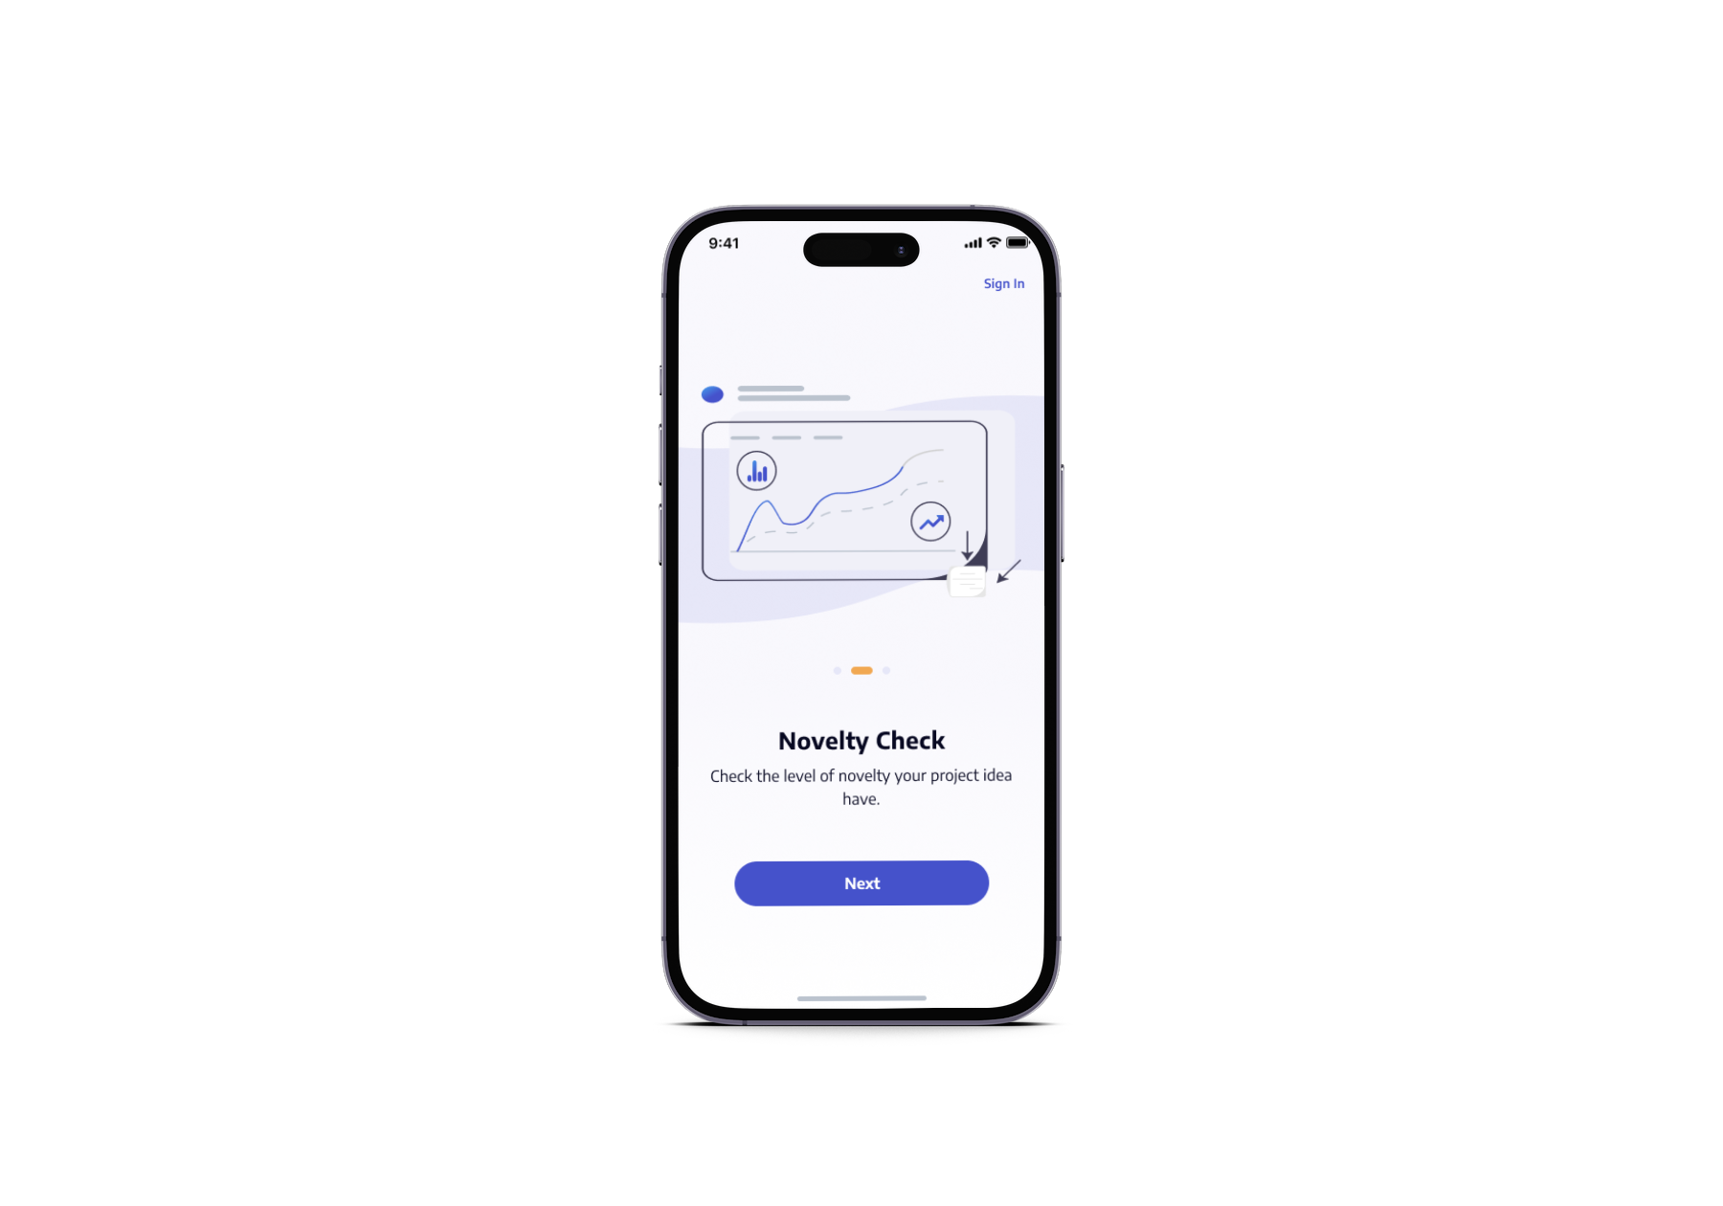
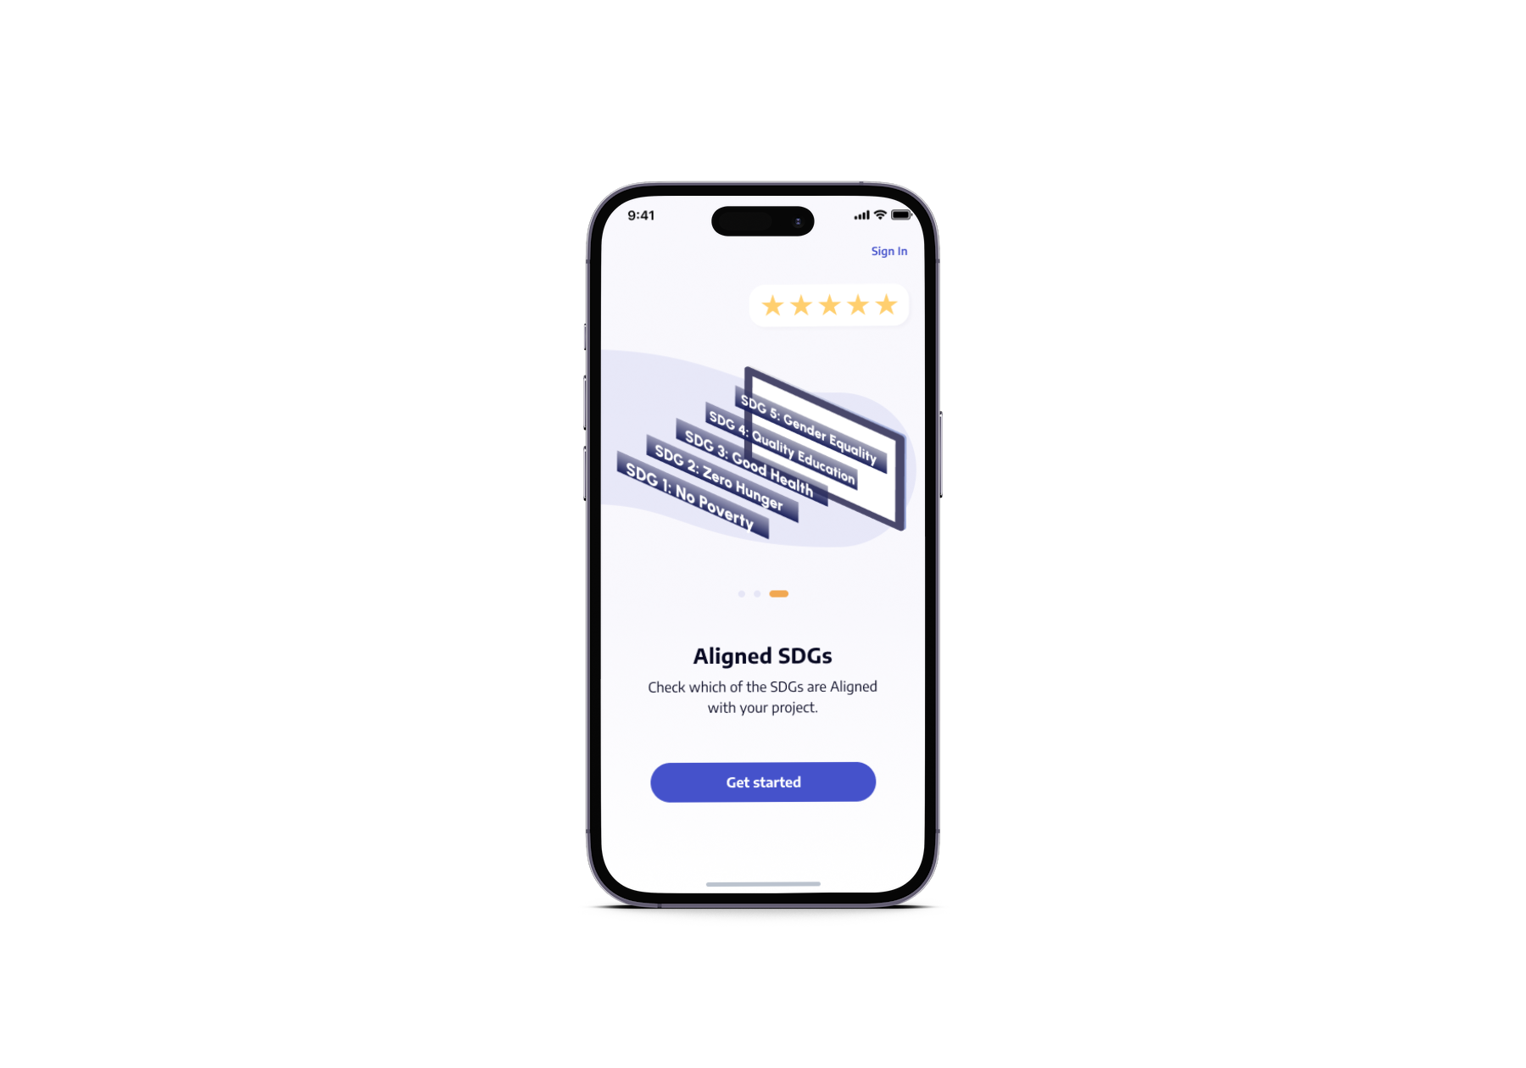
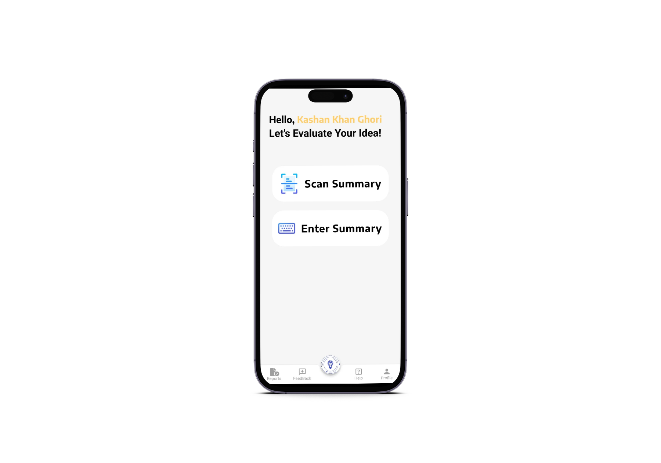
APP USER INTERFACE

Slide 11
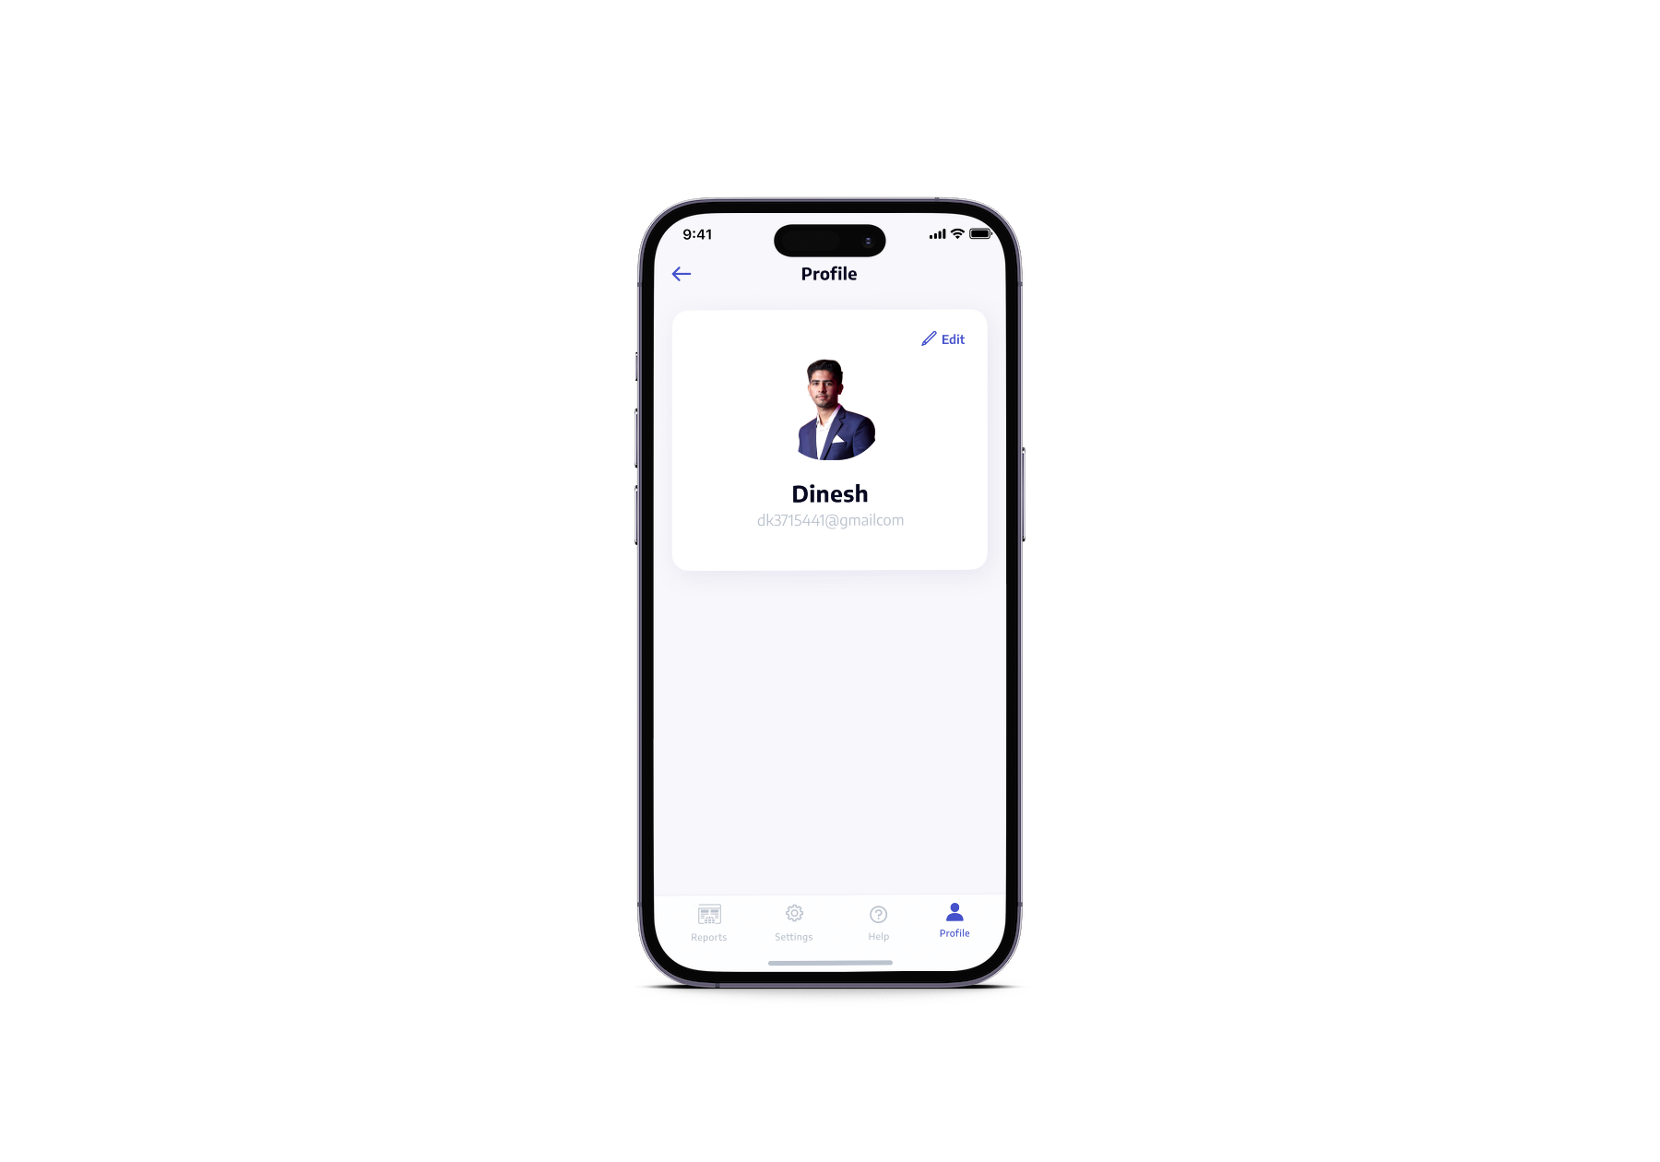
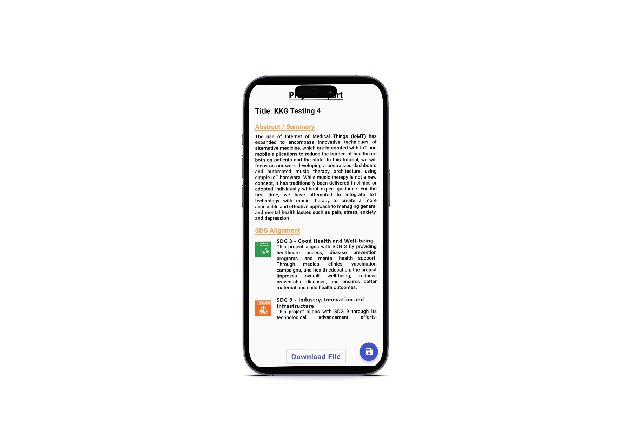
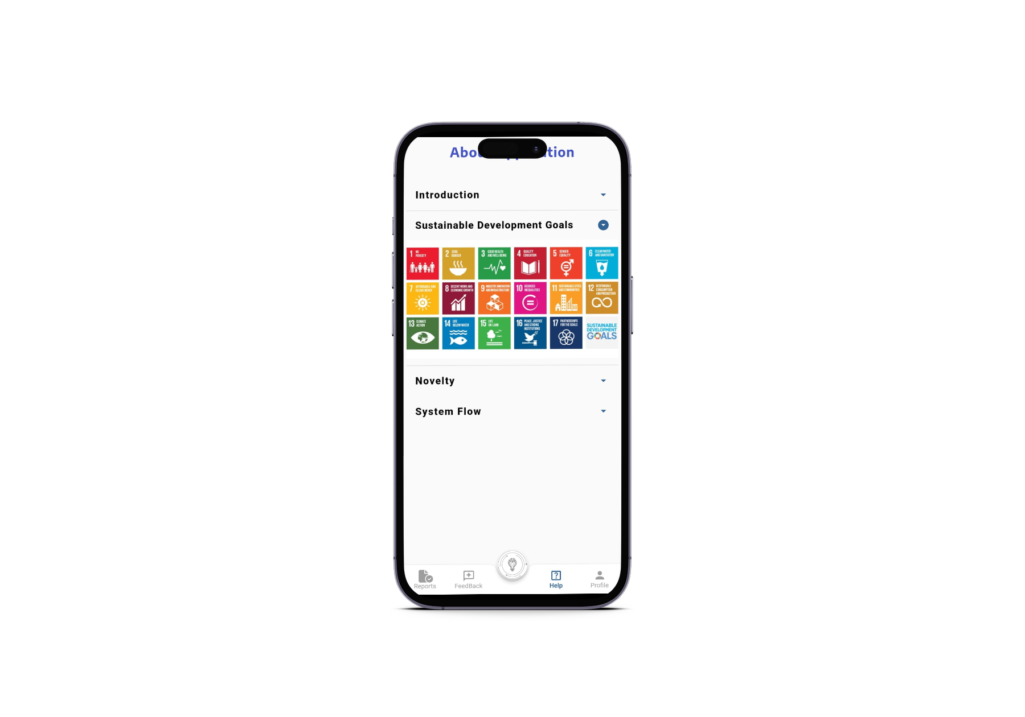
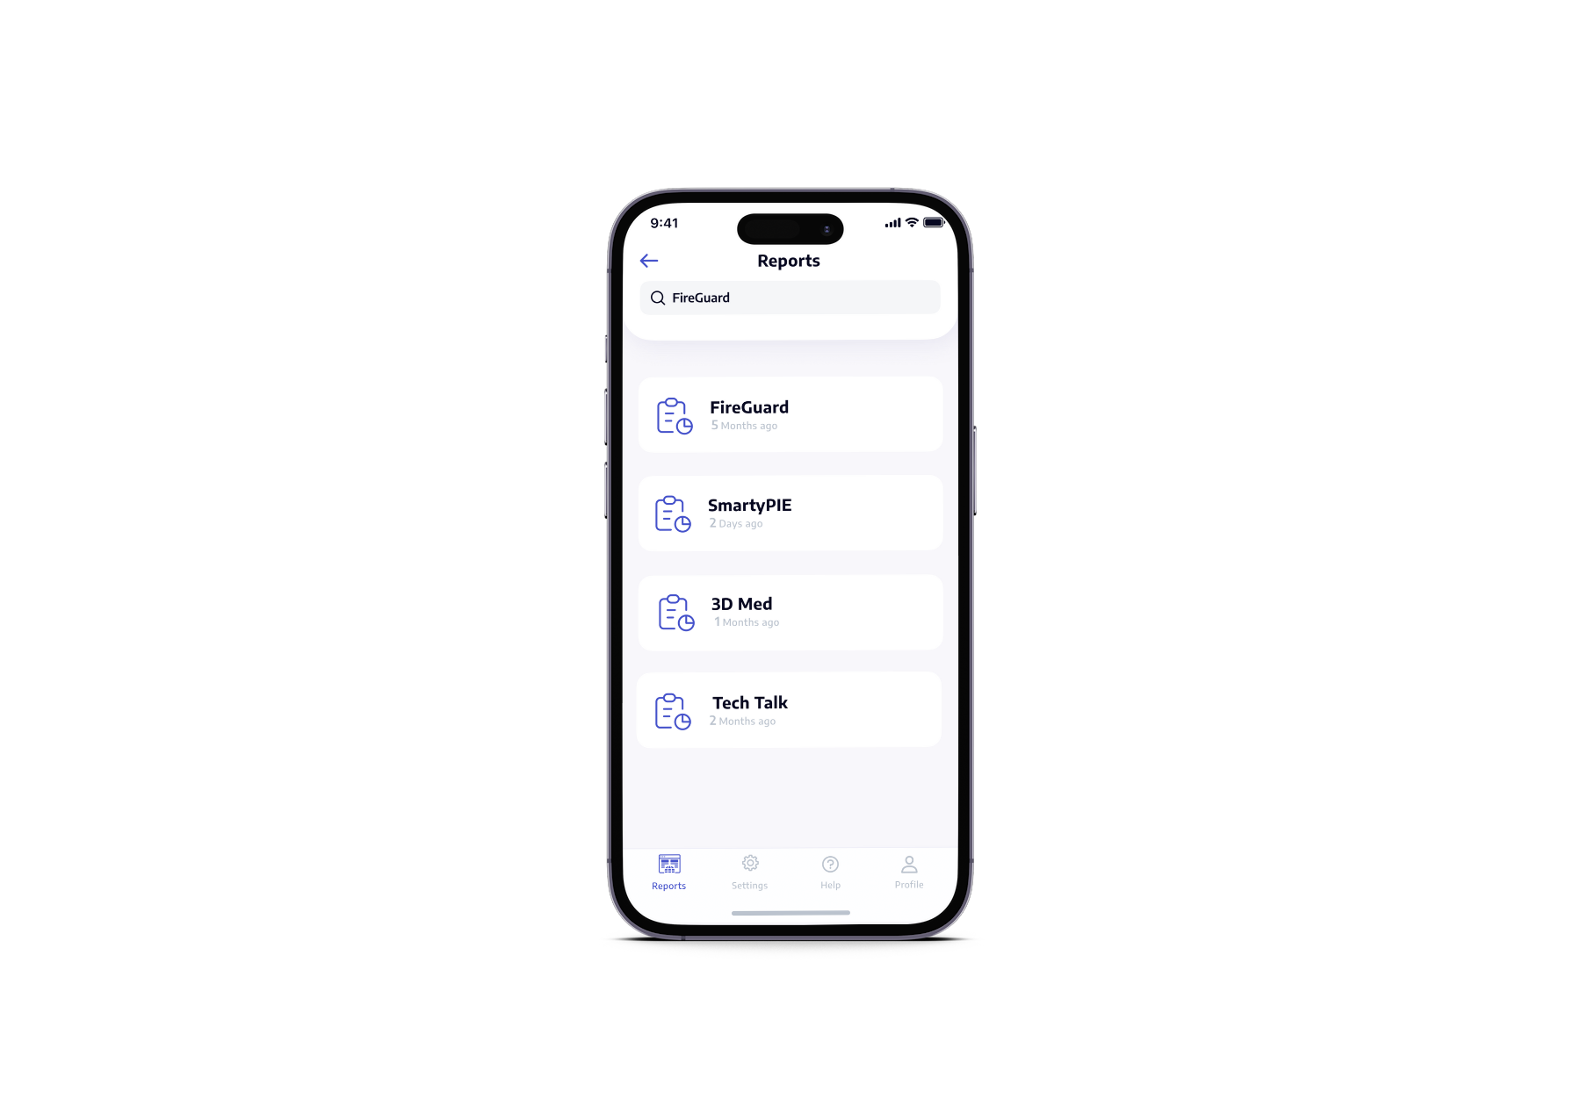
APP USER INTERFACE

Slide 12
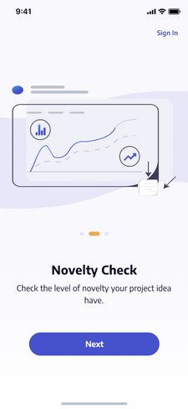

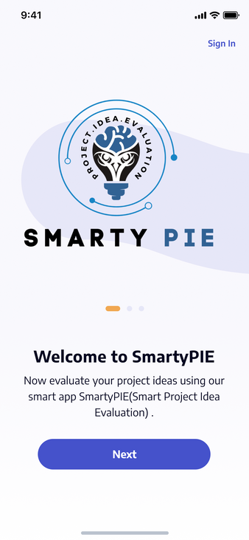
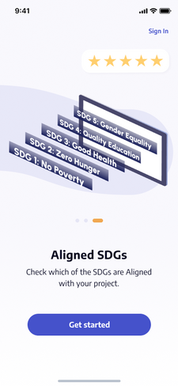
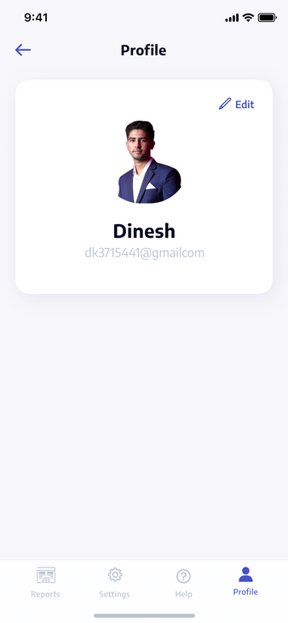
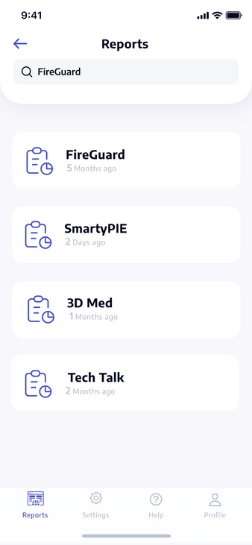
THANK YOU

